Slide 1
IBM MaaS360
How to turn off auto-renew

Slide 2
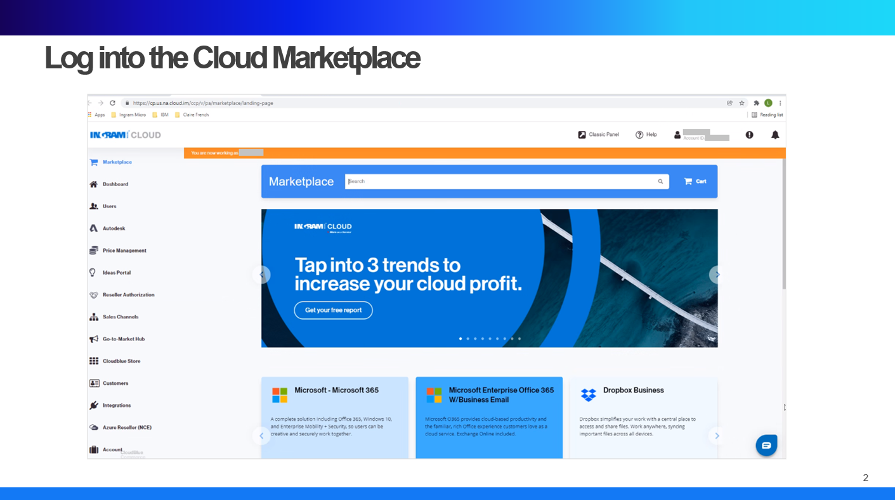

Slide 5
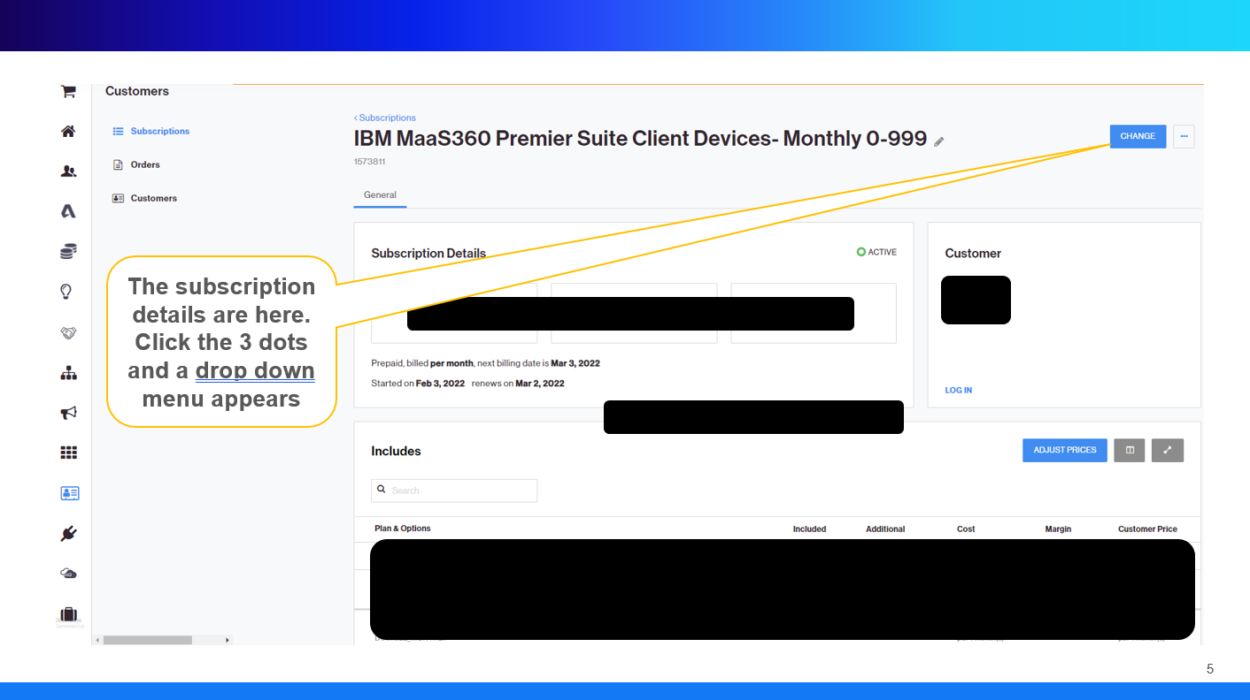

Slide 6
