Slide 1
IBM MaaS360
How to view invoice history

Slide 2
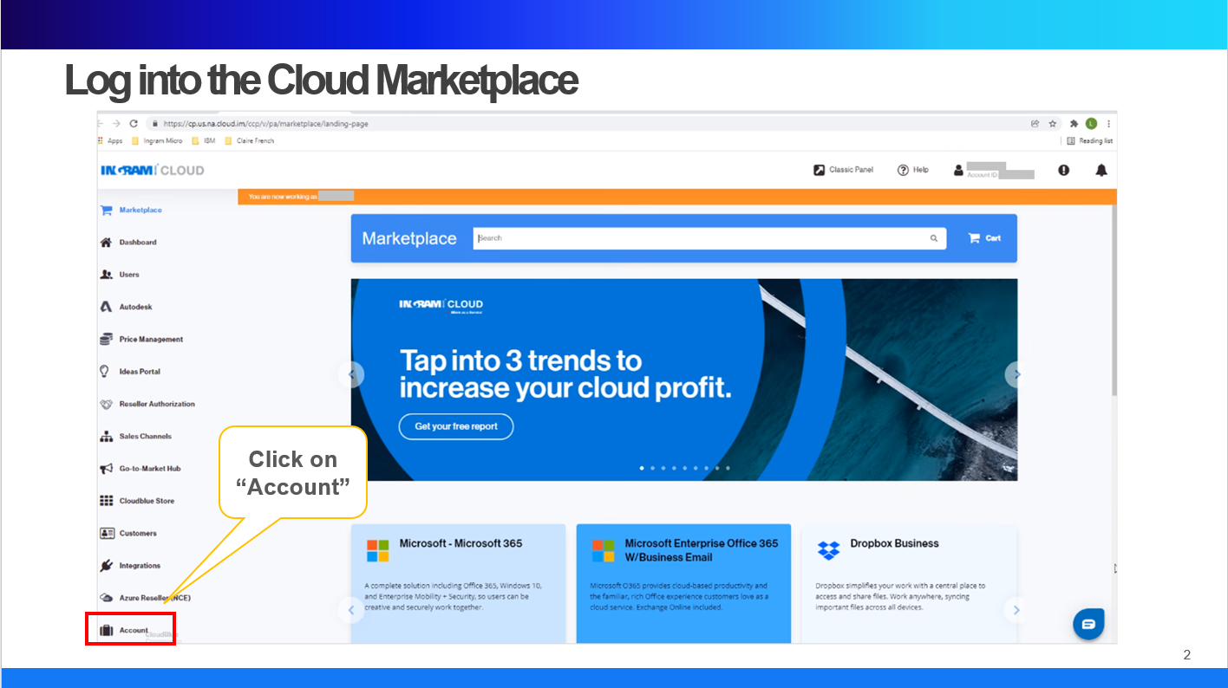

Slide 3
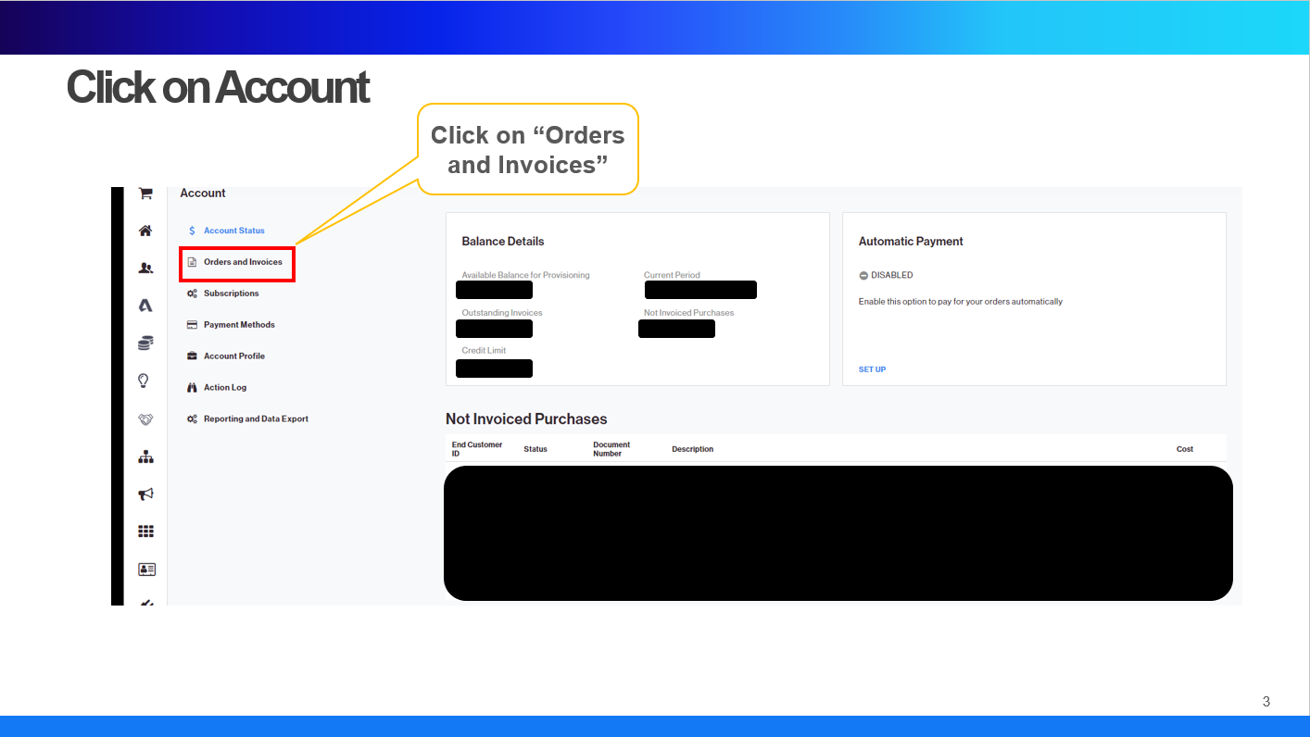

Slide 4
